Slide 1
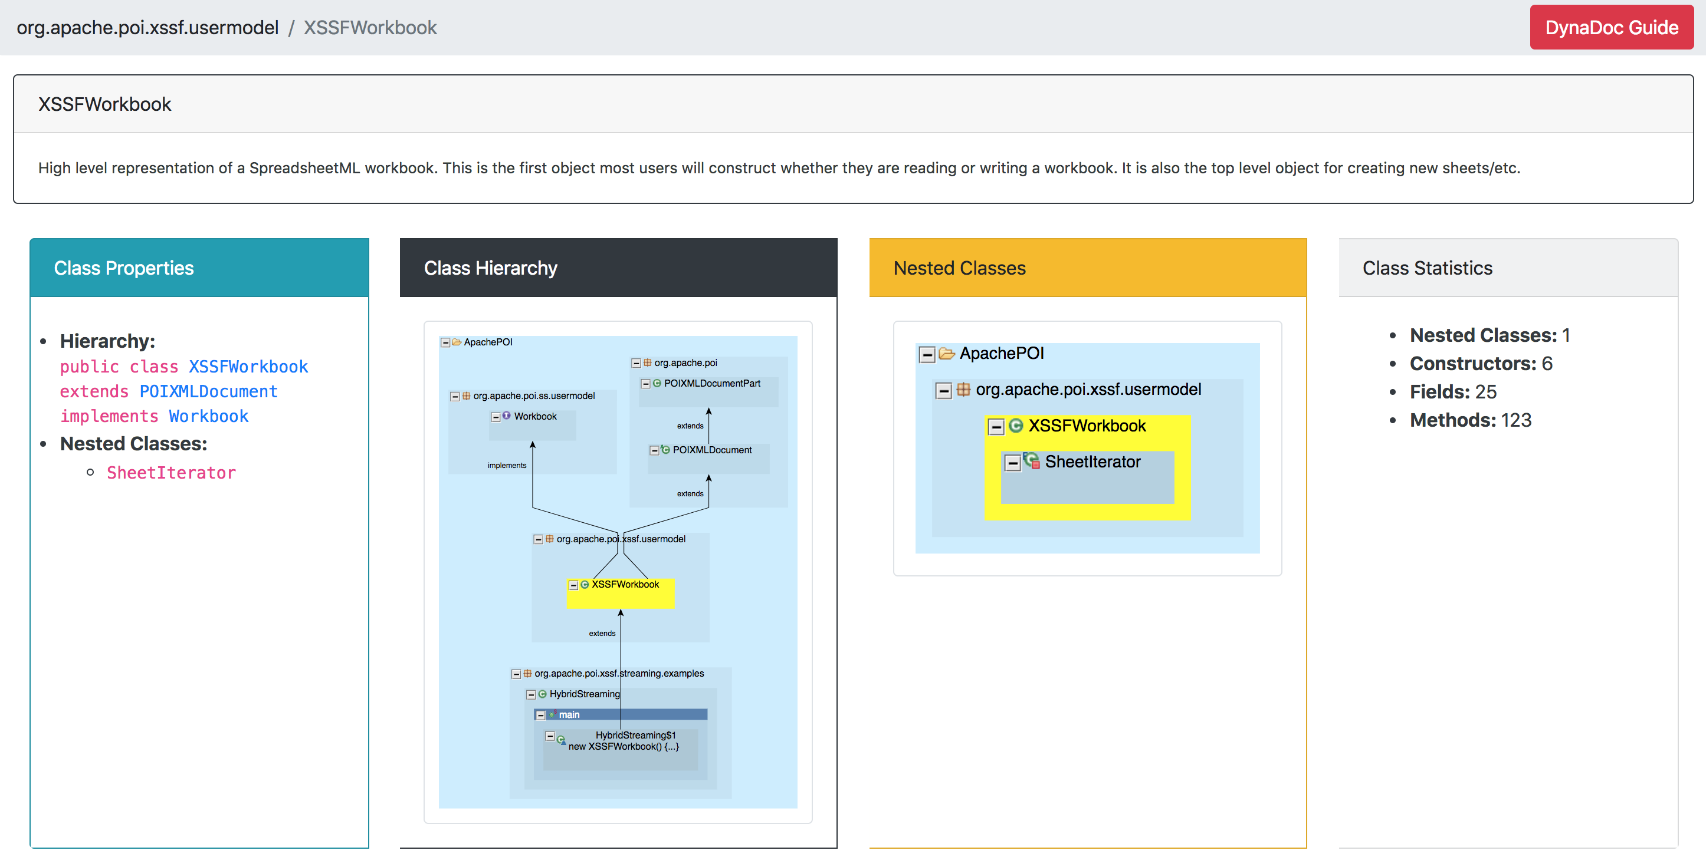
Containing Package Name
User comments for this class
Class Name
The section lists the type hierarchy and the names of nested classes (if any)
This section contains statistics about the class
The graph shows the type hierarchy for the class (highlighted in yellow)
(Clicking the graph will open the full-size graph in a new tab)
The graph shows the nested classes within the class (highlighted in yellow)
(Clicking the graph will open the full-size graph in a new tab)
Class Overview

Slide 2
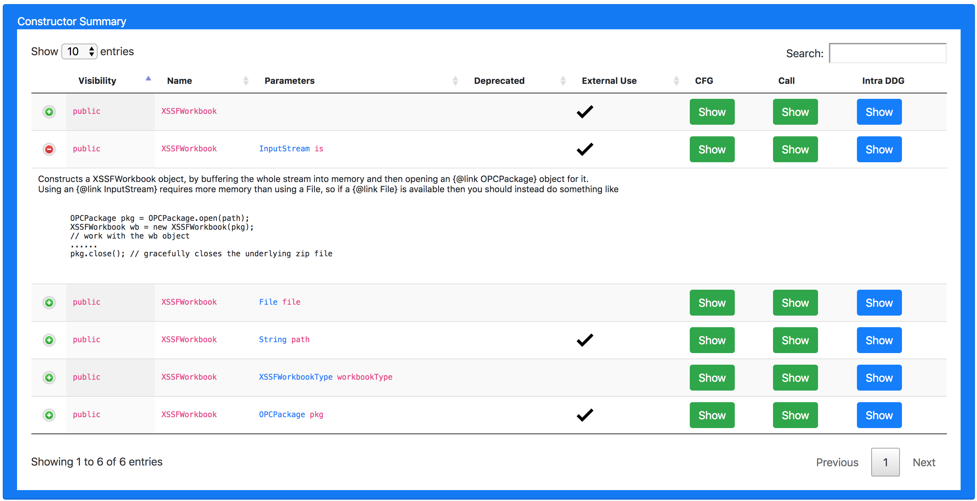
Number of entries shown in one page
Filters the table based on input search term
Whether the constructor is called outside this class
Control Flow Graph
Show/Hide user comments
User comments for the selected constructor
Intraprocedural Data-Dependency Graph
Call Graph
Pagination
Class Constructors Summary Table

Slide 3
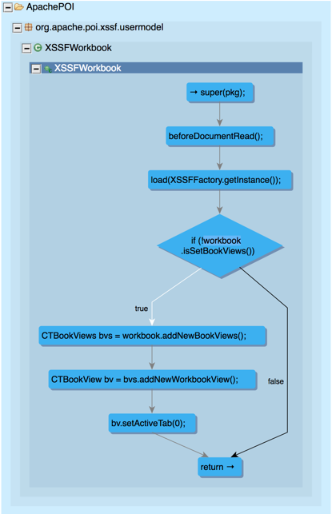
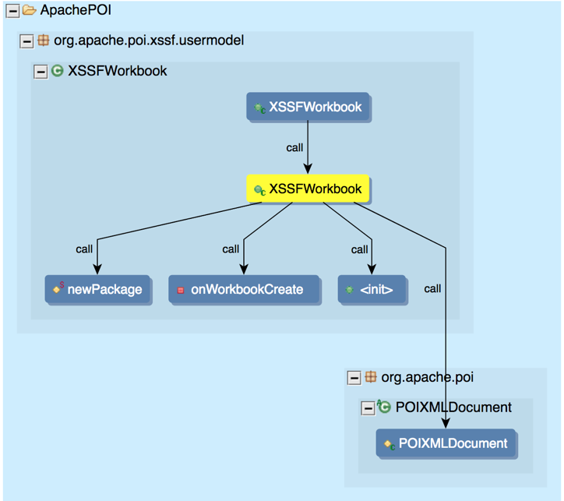
Functions
Statement
Function of Interest
Control Flow Edges
Call Edges
Control Flow Graph
Call Graph

Slide 4
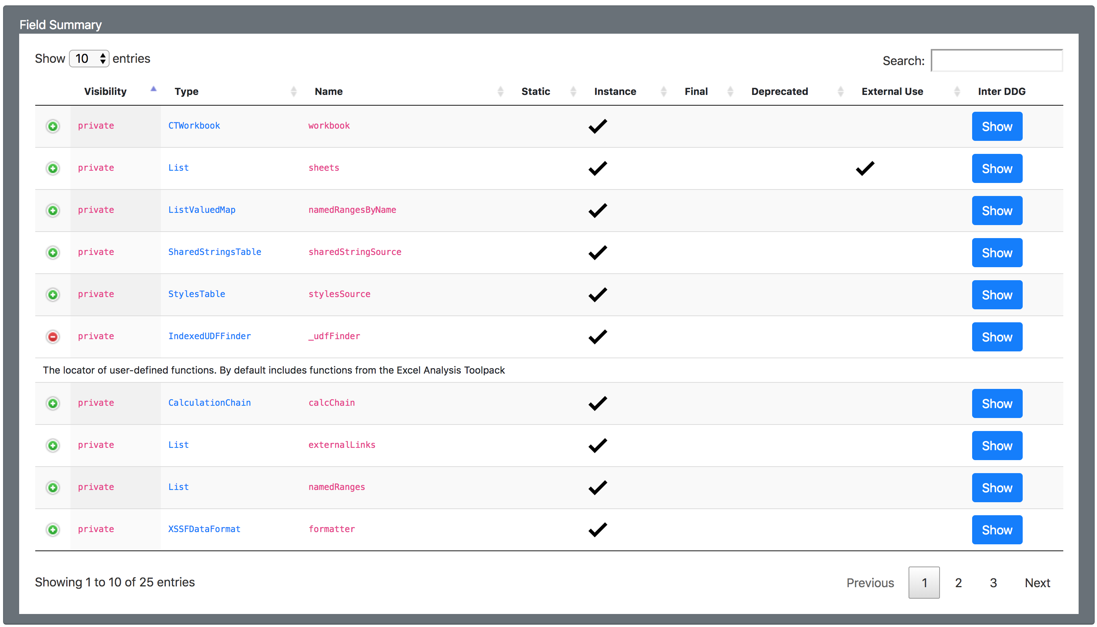
Class Instance Field
Whether the field is used outside this class
Static Field
Interprocedural Data Dependency Graph
The graph shows the values that has been written to and read from this field
Fields Summary Table

Slide 5
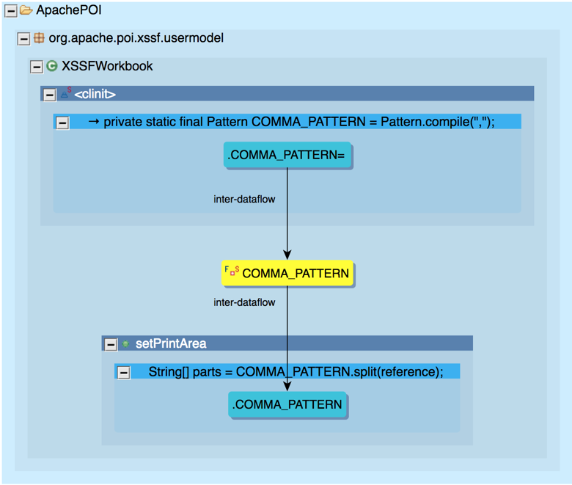
Writes to the field
Data Flow Edges
Field of Interest
Reads from the field
Interprocedural Data Dependency Graph

Slide 6
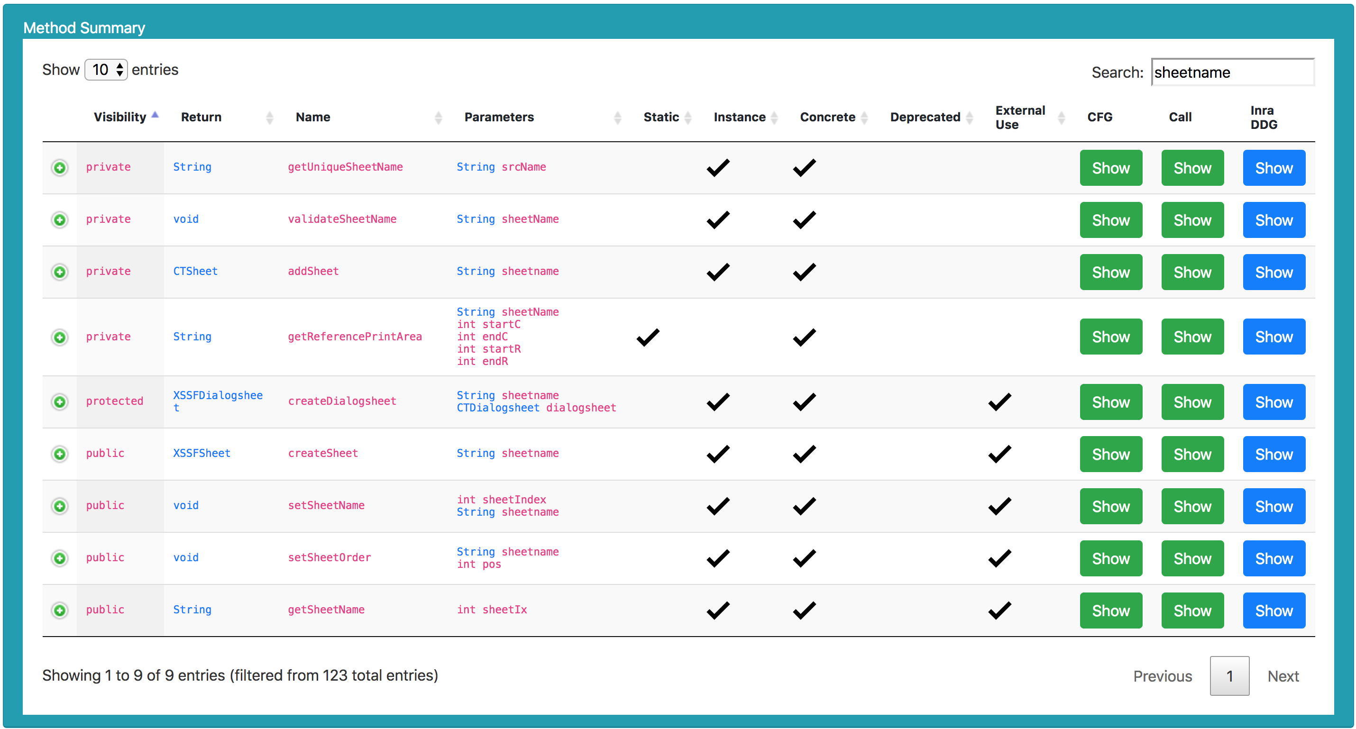
A method that is not abstract
Intraprocedural Data-Dependency Graph
Methods Summary Table

Slide 7
Parameter
Data-Dependency Edges
Intraprocedural Data-Dependency Graph

Slide 8
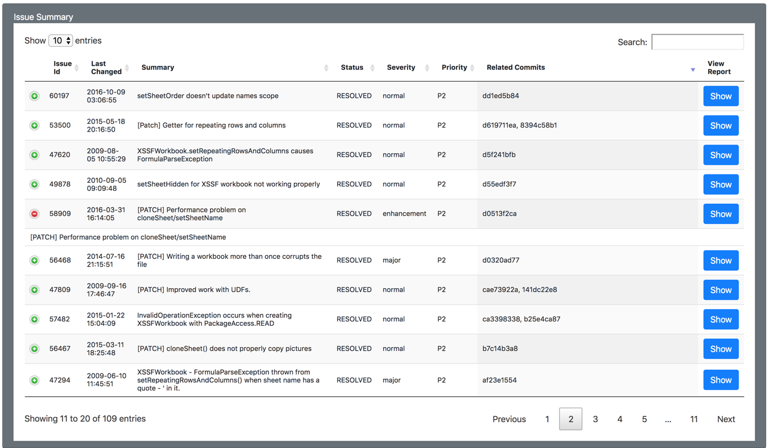
Show/Hide the report summary
Opens the bug report in a new tab
Bugzilla Issues Summary Table

Slide 9
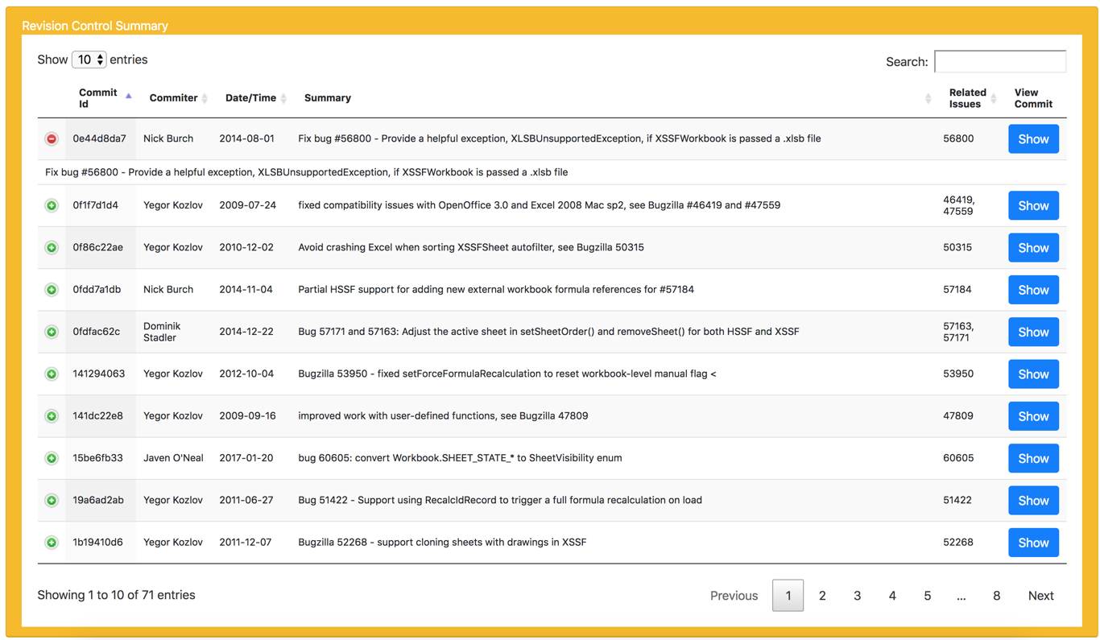
Show/Hide the commit summary
Opens the commit details in a new tab
Revision Control Commit Records Summary Table

